Slide 1
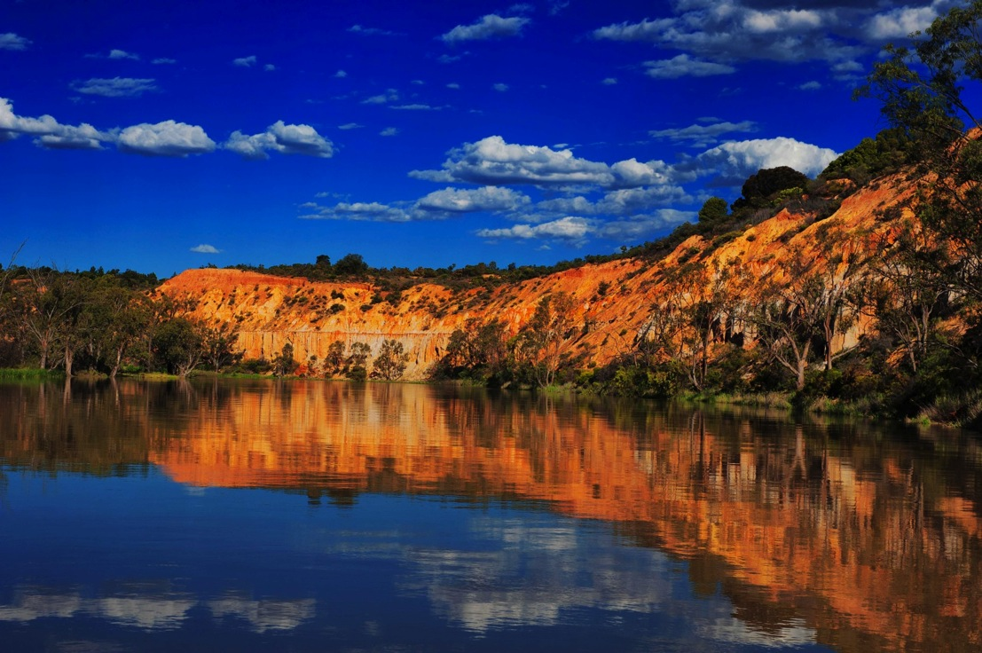


A healthy river and healthy landscapes
means healthy tourism
Tony Sharley, GM, Destination Riverland

Slide 2

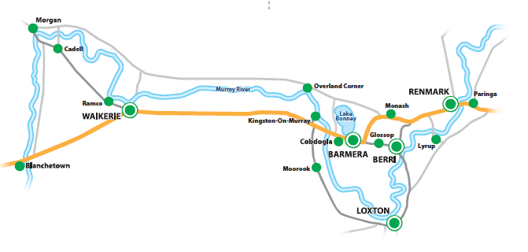
The value of a healthy river
Tourism important driver of economy
SA Tourism Plan 2020 potential - $8.0bn
Riverland Tourism Plan 2020 potential - $216m – up from $142m today

Slide 3
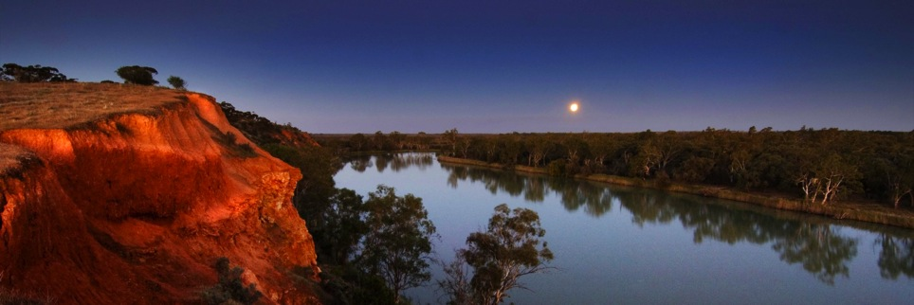
The Planning Framework
A healthy Murray River underpins regional tourism value and growth.
The Basin Plan provides tourism industry with confidence to invest

Slide 4
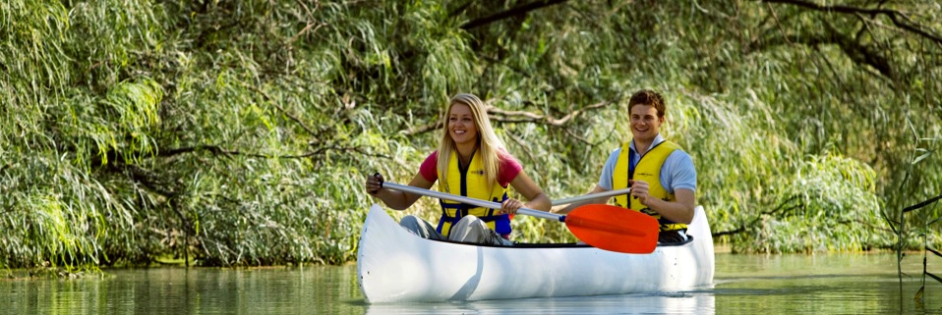
The Current Situation

Slide 5
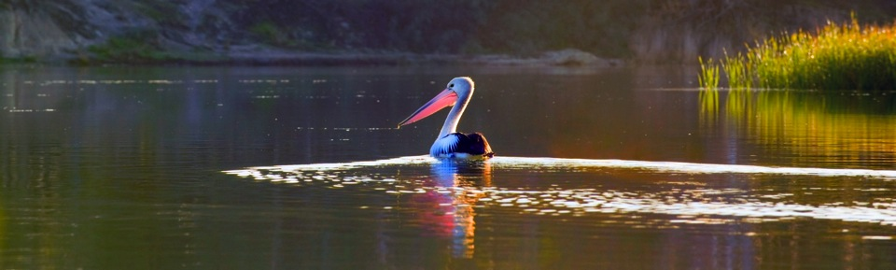
The Current Situation

Slide 6

Future Growth
Deloitte 2014 – tourism in the fantastic 5 growth industries = economic diversification
DR targets the experience seeker
3 most sought after experiences are –
Authentic food, wine and nature

Slide 7
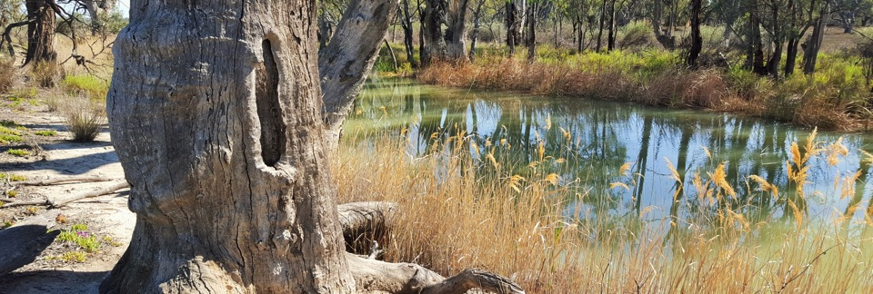
Experiences are enhanced by stories
Aborigines have lived on the Murray River for 40,000 years – connected to its food cycles
Evidence of their connection to the river is everywhere

Slide 8
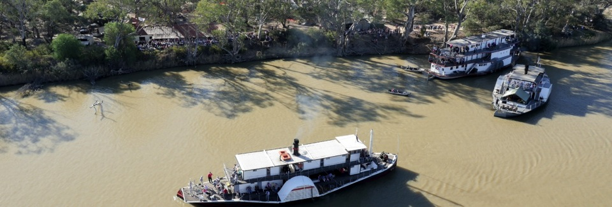
Stories enhance the experience
Pastoralism and paddle-steamers grew up together. Chowilla Station was 150 yo in 2014.
The historic Port of Morgan boasted 2 brothels and a morgue in 1880.

Slide 9
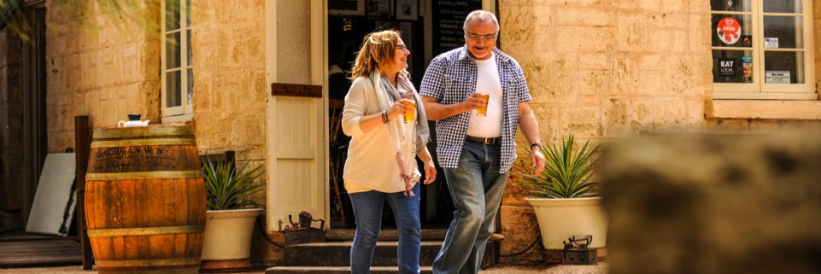
Stories enhance the experience
The Overland Corner Hotel was built in 1859.
Today it offers a connection to the past with local food and wine, walks and a ghost

Slide 10
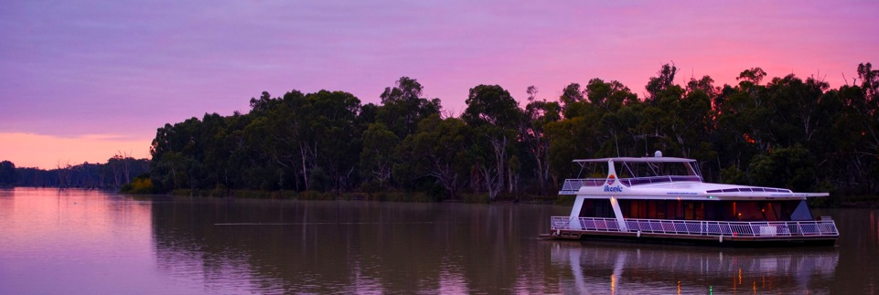
Stories enhance the experience
The Riverland is the birthplace of houseboat tourism. Ian Showell launched the first Liba Liba houseboat in 1961.
There are 100 Riverland houseboats for hire.

Slide 11
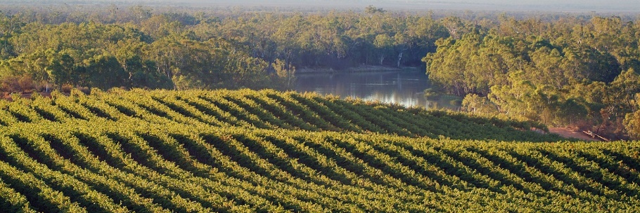
Stories enhance the experience
The Riverland is the birthplace of irrigation in Australia….and today it’s the most efficient.
The Riverland produces 60% of SA wine grapes, 80% SA citrus, 80% SA almonds

Slide 12

Part of the Story
The Landcare Link
1996 Landcare Conference – Riverland & Mallee Challenges – wetland management, irrigation salinity and training, soil erosion, feral animals, species extinction, native foods, revegetation, leadership and group behaviour
PLAYERS – PIRSA, DEHAA, MDBC, Landcare groups, LAPs, Soil Boards, Irrigation Boards, CARE, Councils.

Slide 13
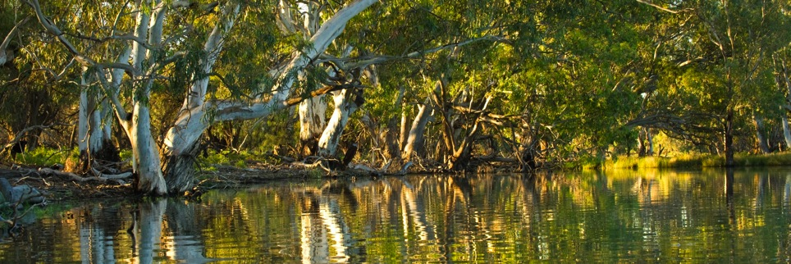
The New Story
The Landcare Link
2015 – Water Stewardship, Basin Plan, Precision Irrigation, Wetland Watering, Private landcare champions, Ramsar Sites, Climate change adaptation, Minimum till, Organic horticulture, Niche crops – capers, dates, Murray Cod.
PLAYERS – Industry Orgs, businesses, Birds Australia, Banrock Station, ALT, NRM Board, MSFP, LAPs, Councils, Landcare, SADEWNR, MDBA, CEWH, ALT, NFSA, CHASA….collaboration

Slide 14
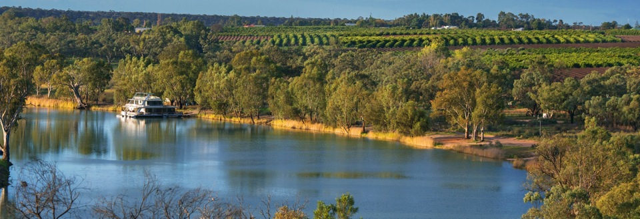
The Potential Story
The Riverland Landcare Link
2036 Worlds No1 Ecologically Sustainable Food Source, Most trusted food source, integrated Landcare, 100% organic food/wine production, endangered species stabilisation, climate adaptive & resilient, collaboration across food/wine/nature/tourism industries. Carbon sequestration growing. Authentic food, wine, nature experiences all with a Landcare Link – and demonstration of care.
Plans to assist – Annual Marketing Plan, TRA/SATC Reports, Riverland Visitor Surveys

Slide 15
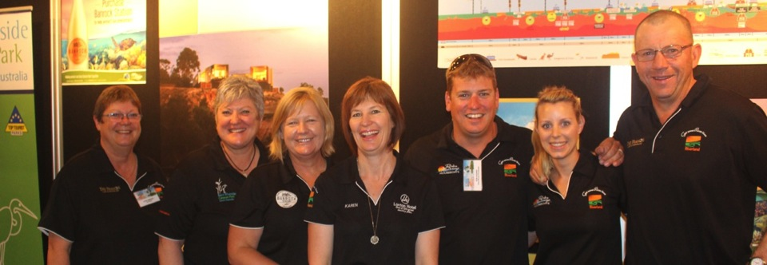
The Potential Story
The Landcare Link
2036 – Powerful brand - Riverland embraces Landcare Link. Tourism Industry 20% of GRP up from 12% in 2014.
Landcare Link a trusted marketing brand.

Slide 16
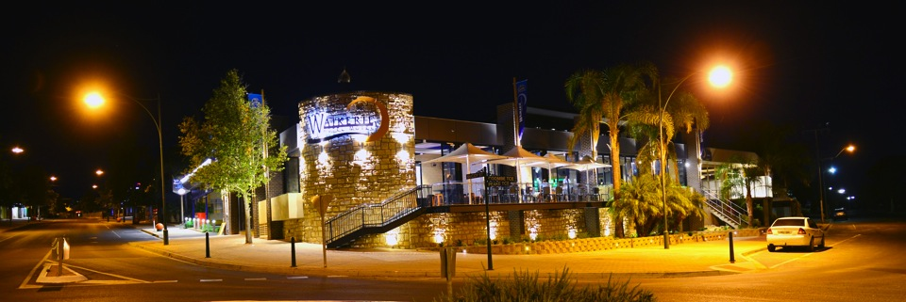
Who will share the
Landcare Link ?
Every visitor will demand it and value it.
Every business will become an ambassador
Trail guides, National Parks HQ, Food markets,
Product packages/labels, websites etc, VICs
Landcare Link will be the new ??????????

Slide 17
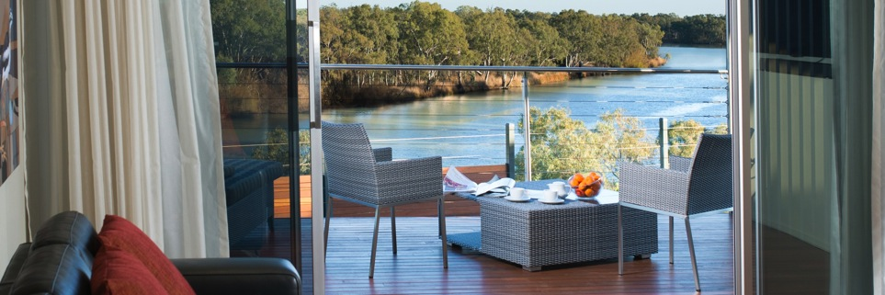
Take home messages ?
Tourism is all about experiences in regions
Food, wine and nature are highly prized experiences
Combining regional food, wine and nature is smart
Stories enhance the experience, create pride
Build Landcare stories into the tourism experience
Think about the Landcare Link! 2036?

Slide 18
A healthy river and healthy landscapes
means healthy tourism
Tony Sharley, GM, Destination Riverland

